Slide 1
Suicides & Deaths Causes
Project III
Sabina Shahbazzade

Slide 2
Questions:
What are the range of ages suicides occurred mostly?
Females or males most committed suicides?
What are the top 5 countries have the highest number of suicides in 2016?
Is this result of countries change consider the population numbers for the countries?
What are the top 5 countries have the highest number of suicides in 2015?
Is this result of countries change consider the population numbers for the countries?
Is this result are the same as in 2016?
What are the main causes of deaths in the world in 2017?
Are these change in 2016 and 2000?
What are the most 2 death diseases in United States, 2017?
Are these two diseases were the same in 2016 and 2000?

Slide 3

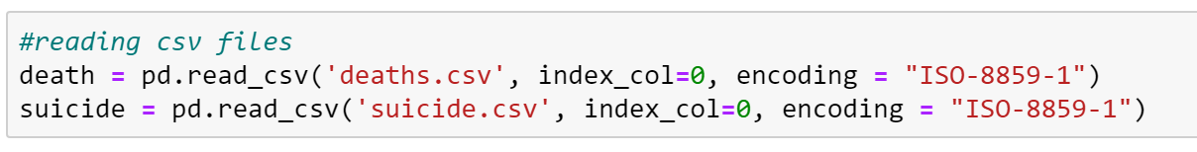
Code – import, reading datasets: deaths & suicide
Importing libraries

Slide 4
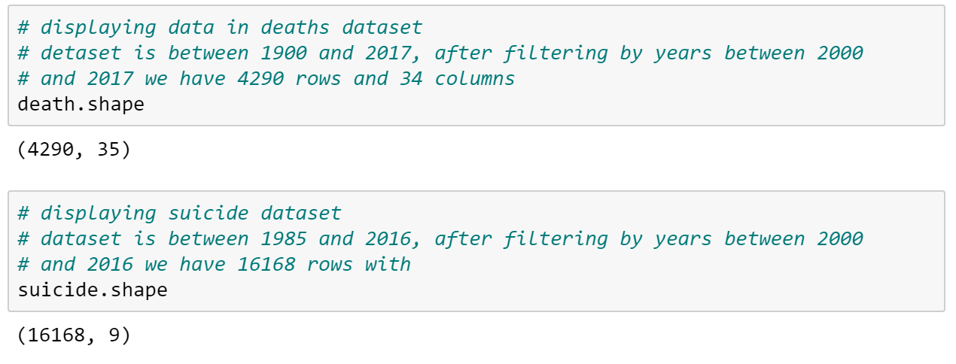
Code – structure of the datasets
Number of rows and columns in the original death dataset are 4,290 and 35
Number of row and columns in the original suicide dataset are 16,168 and 9

Slide 5
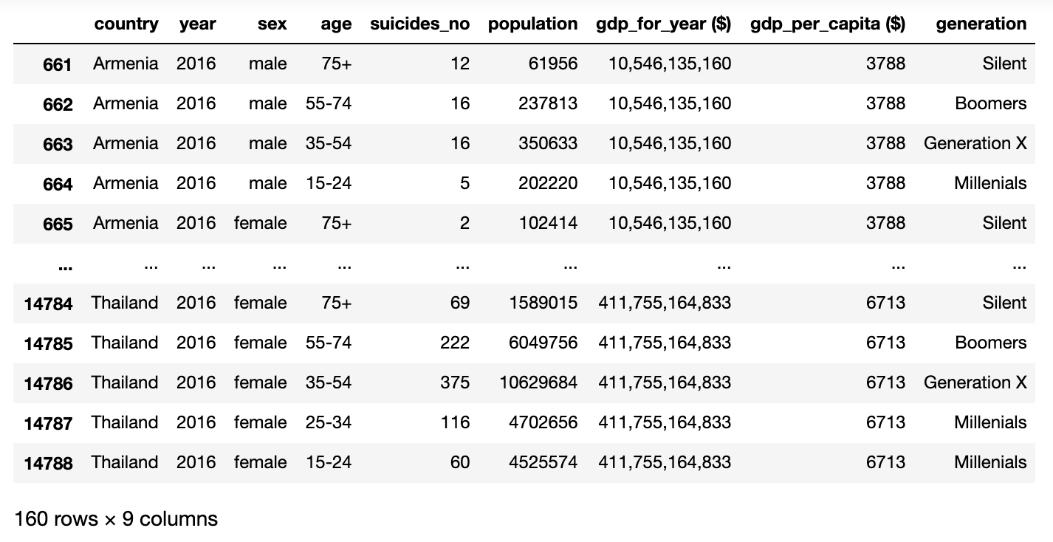

Code – suicide dataset in 2016

Slide 6
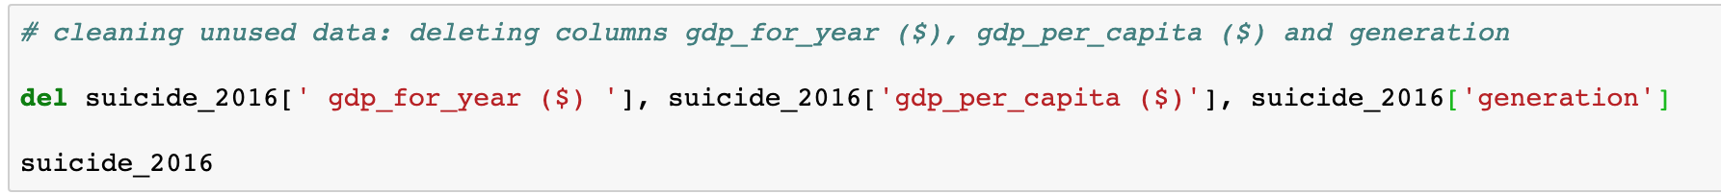
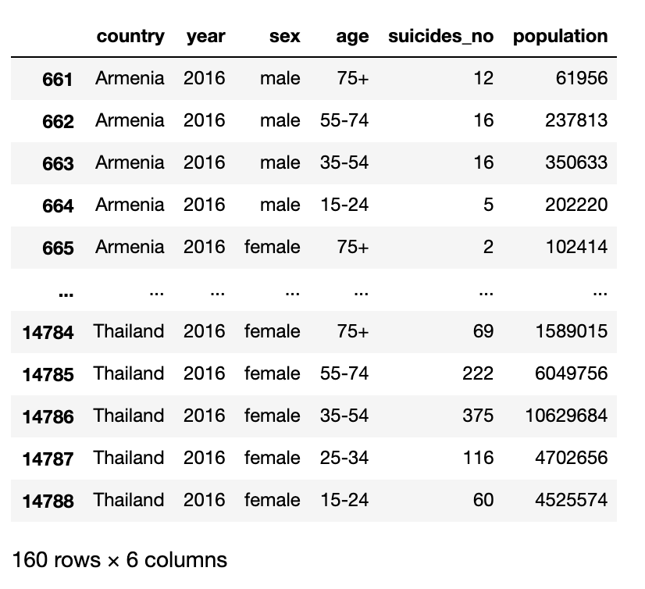
Code – Cleaning unused data for future analysis

Slide 7
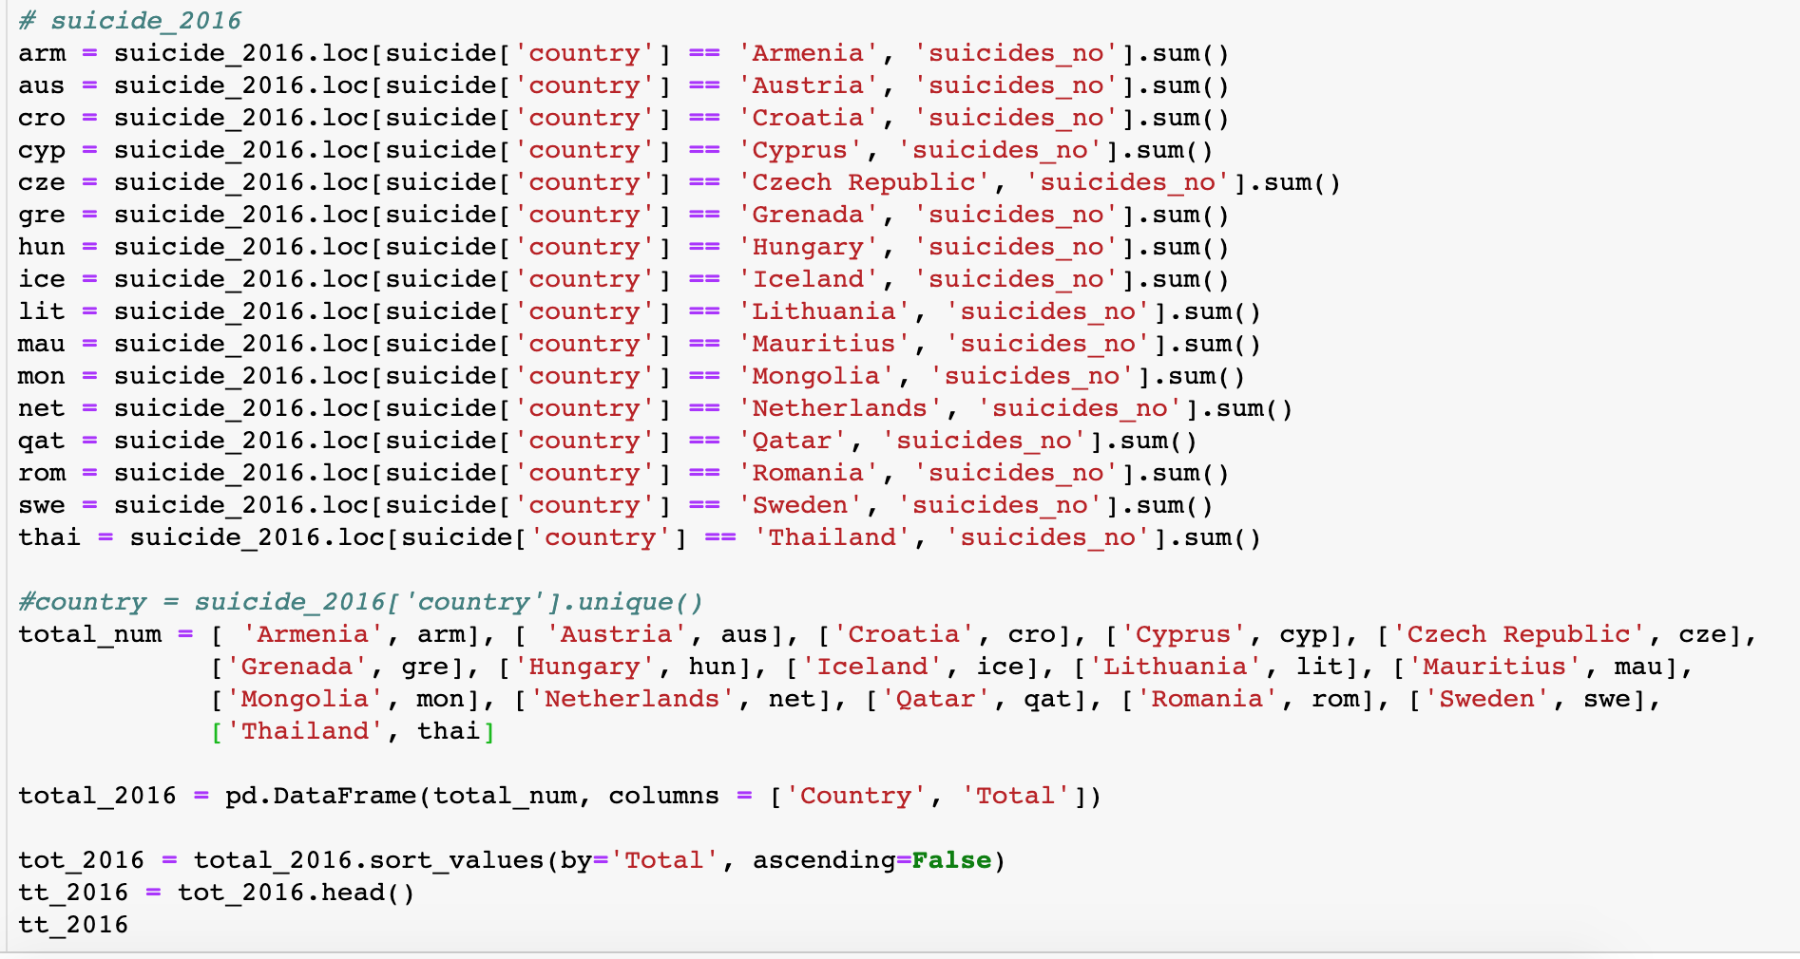
Code - Creating a new dataset with sum of suicide numbers for every country in 2017

Slide 8
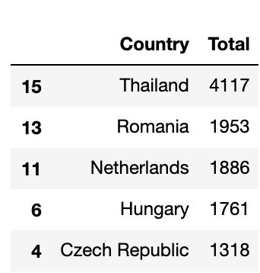
Code - output

Slide 9
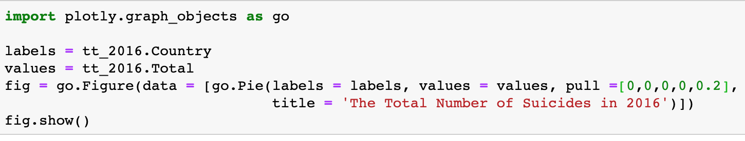
Code – Pie Chart

Slide 10
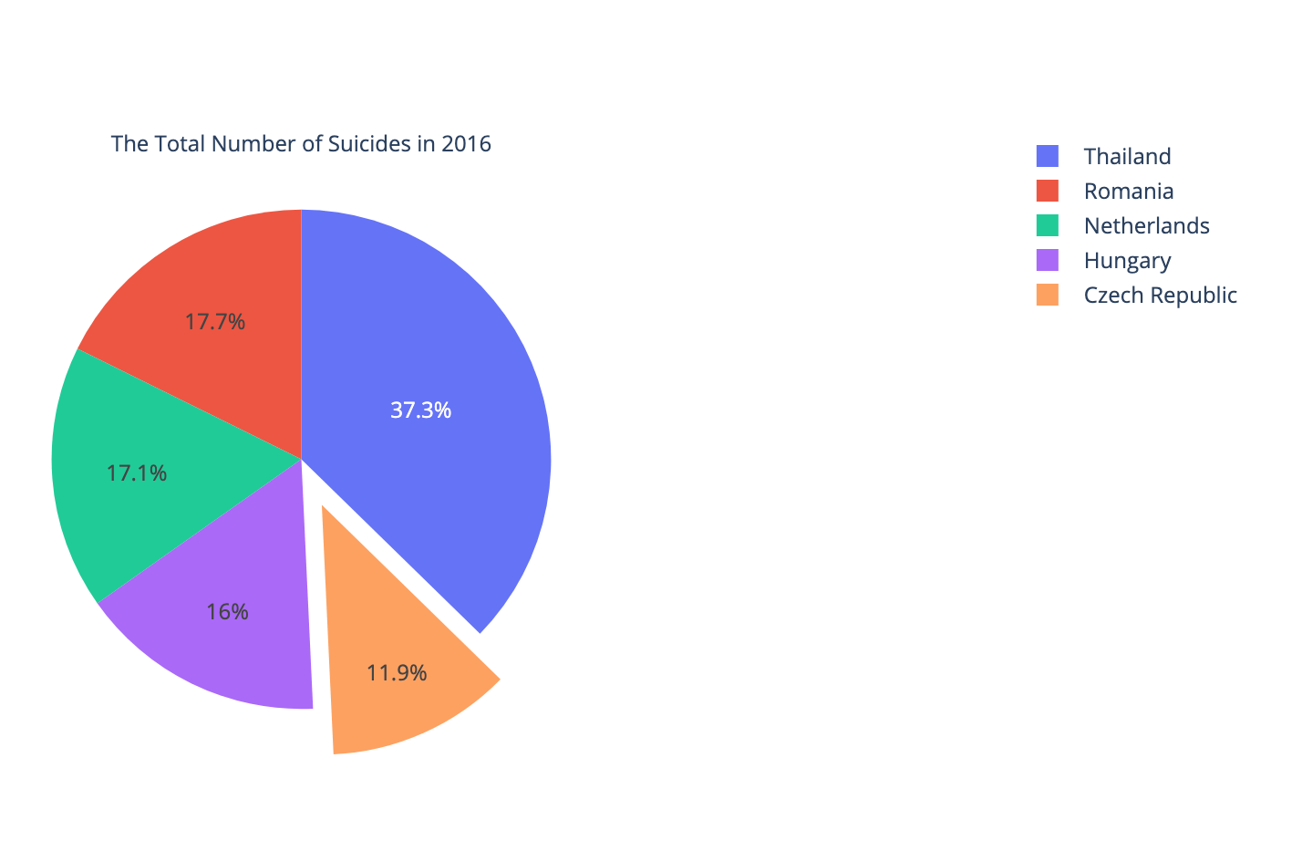

Slide 11
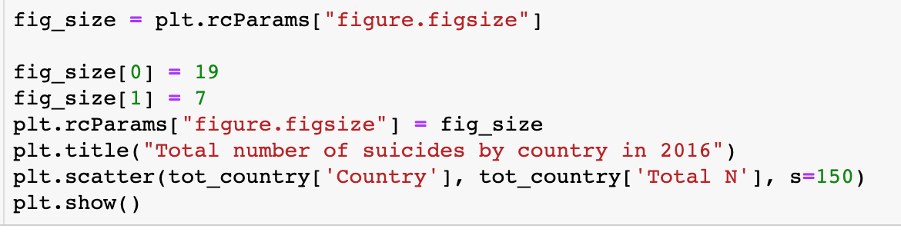
Code – Scatter Plot

Slide 12
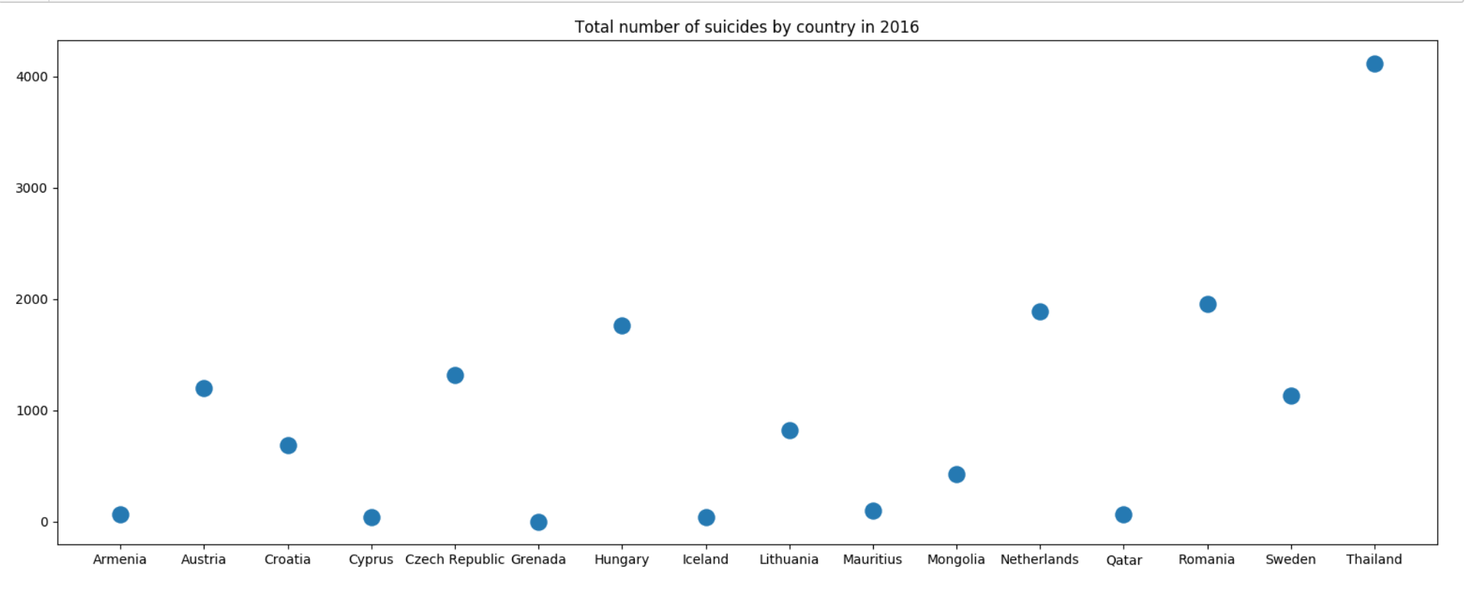

Slide 13
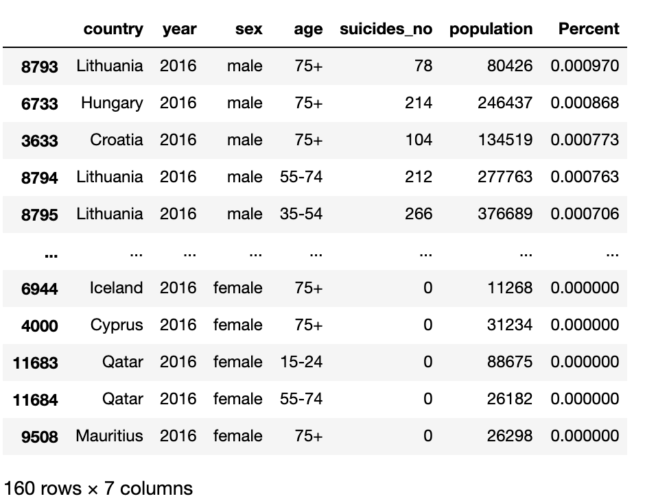
Code – adding Percent

Slide 14
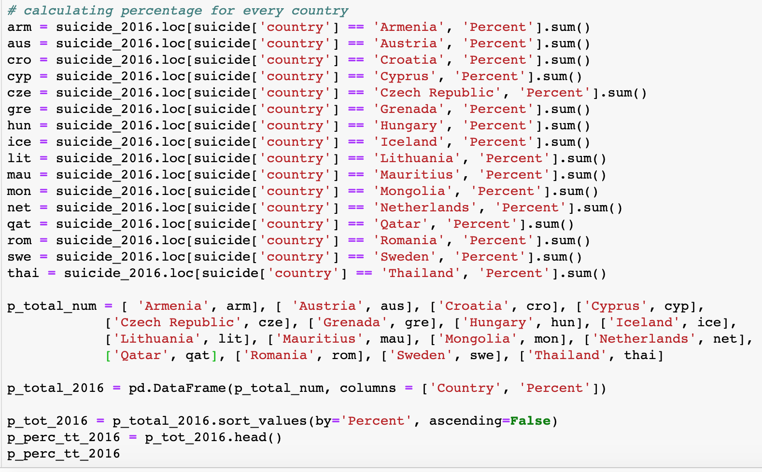

Slide 15
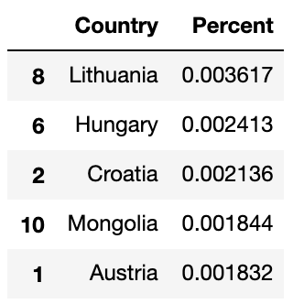
Code – Percentage 2016

Slide 16
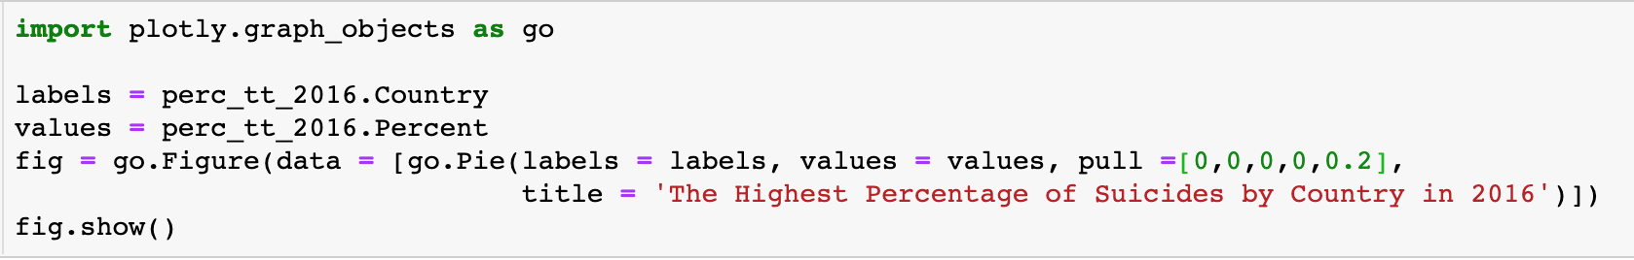
Code – Pie Chart

Slide 17
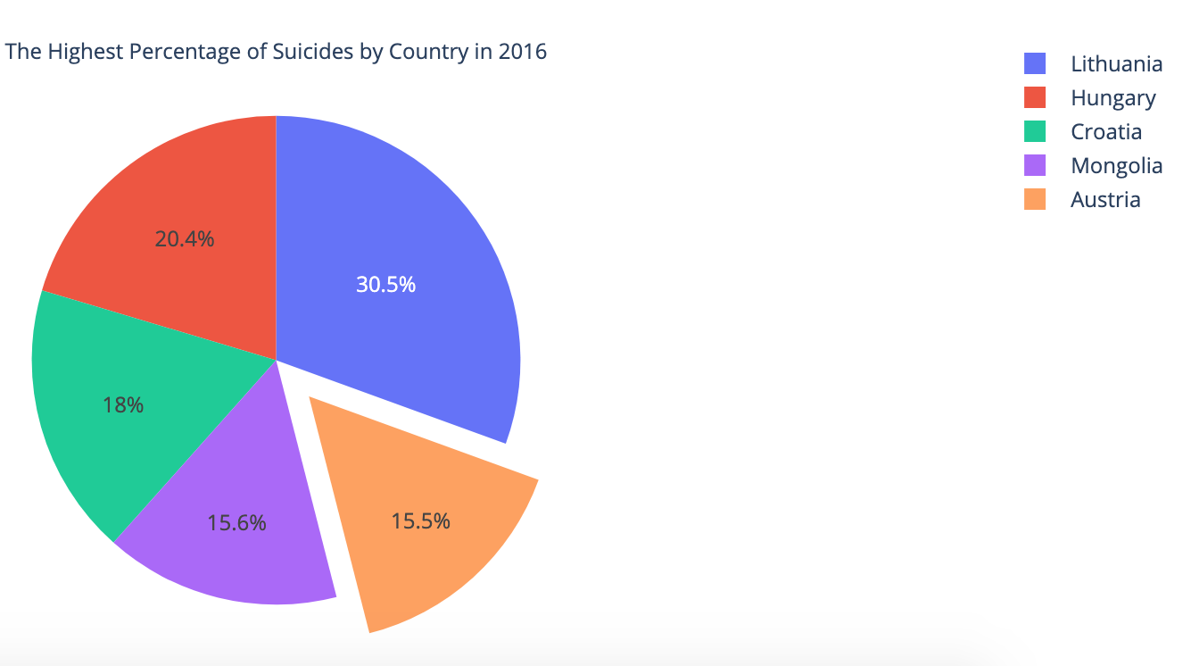

Slide 18
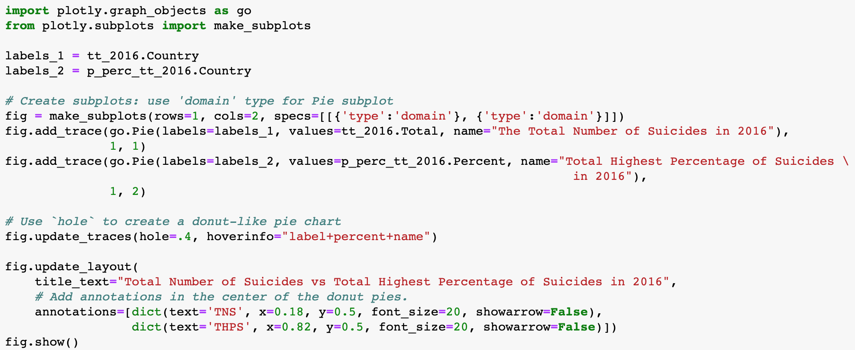

Slide 19
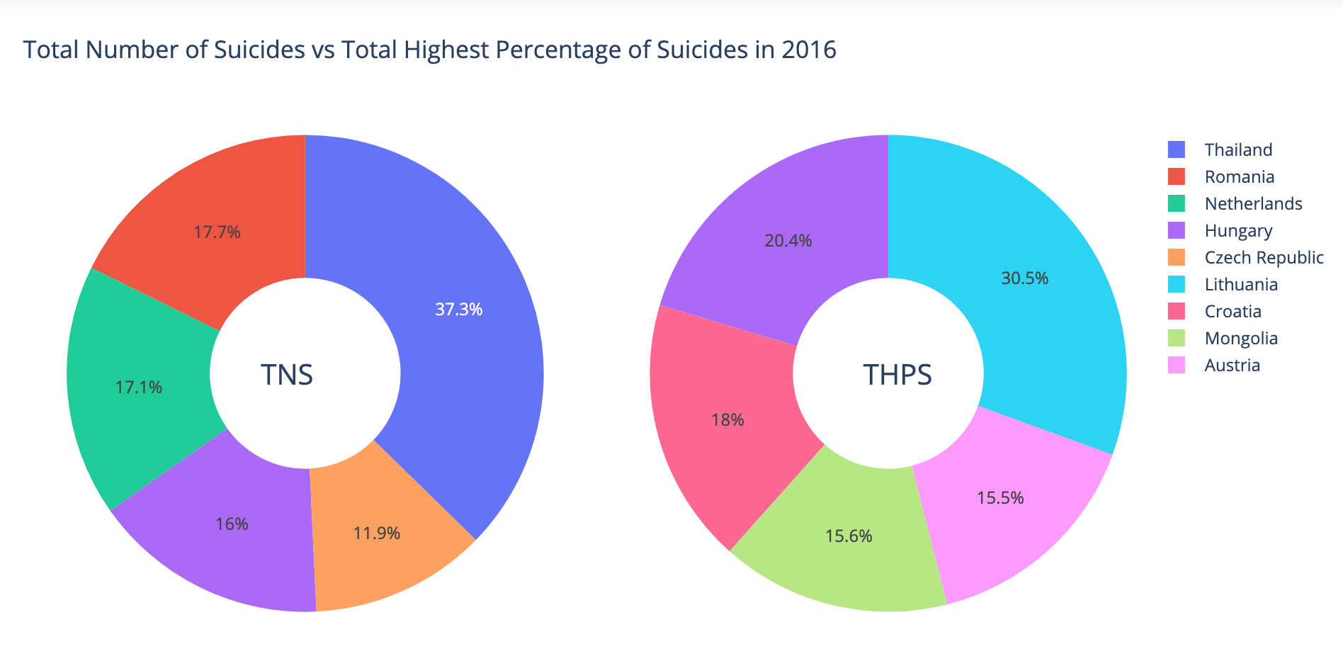

Slide 20
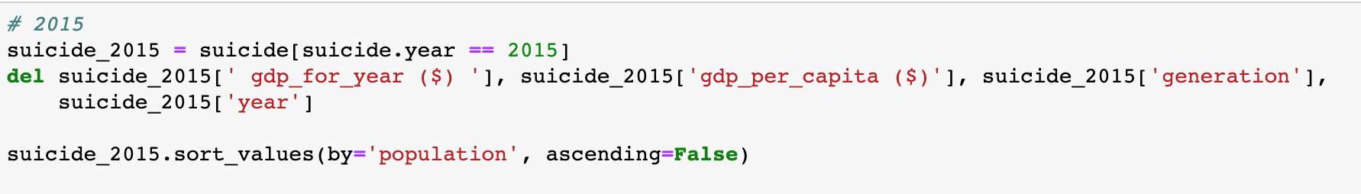
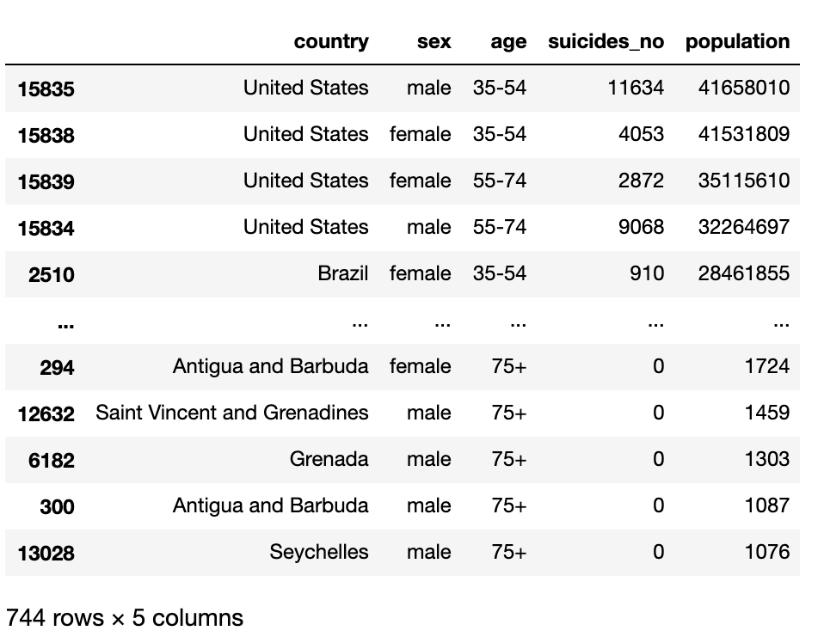

Slide 21
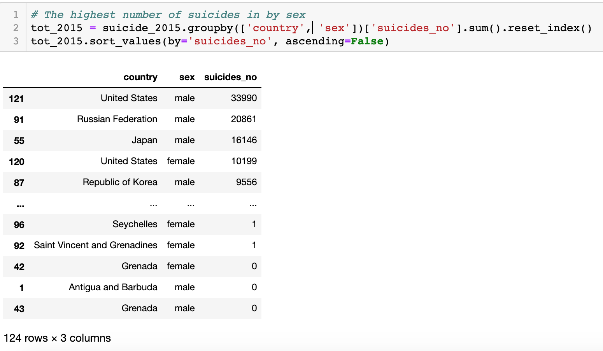

Slide 22
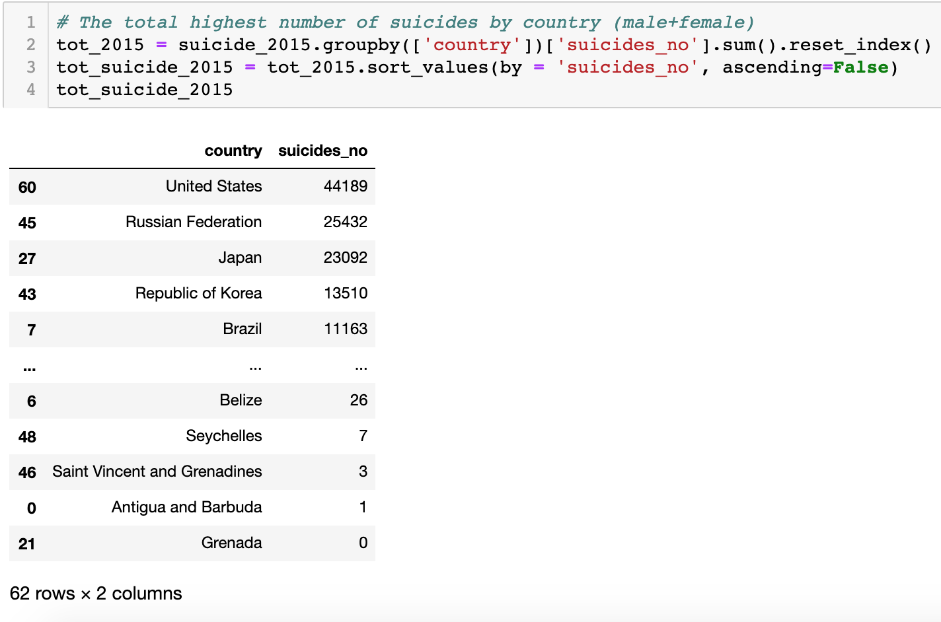

Slide 23
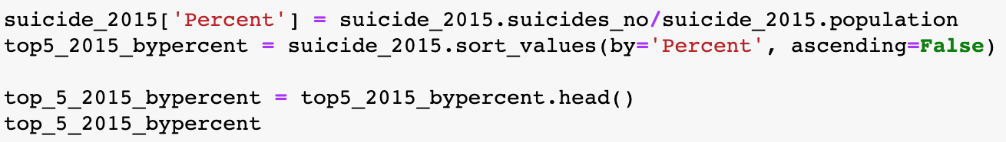
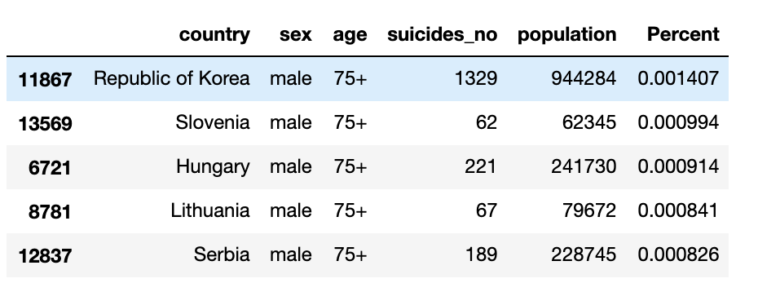

Slide 24
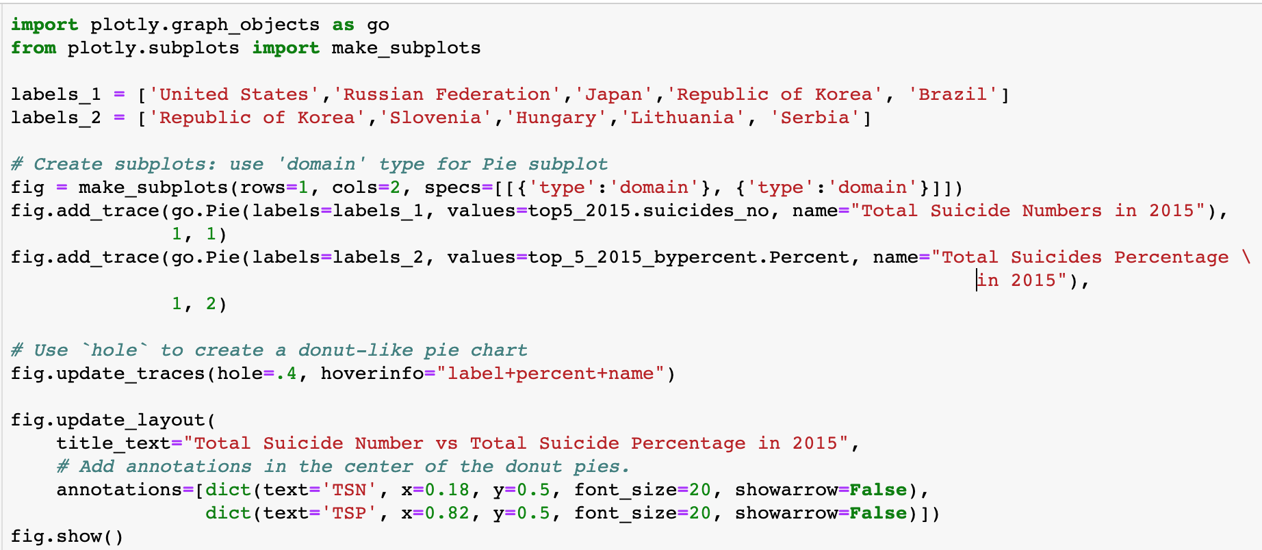

Slide 25
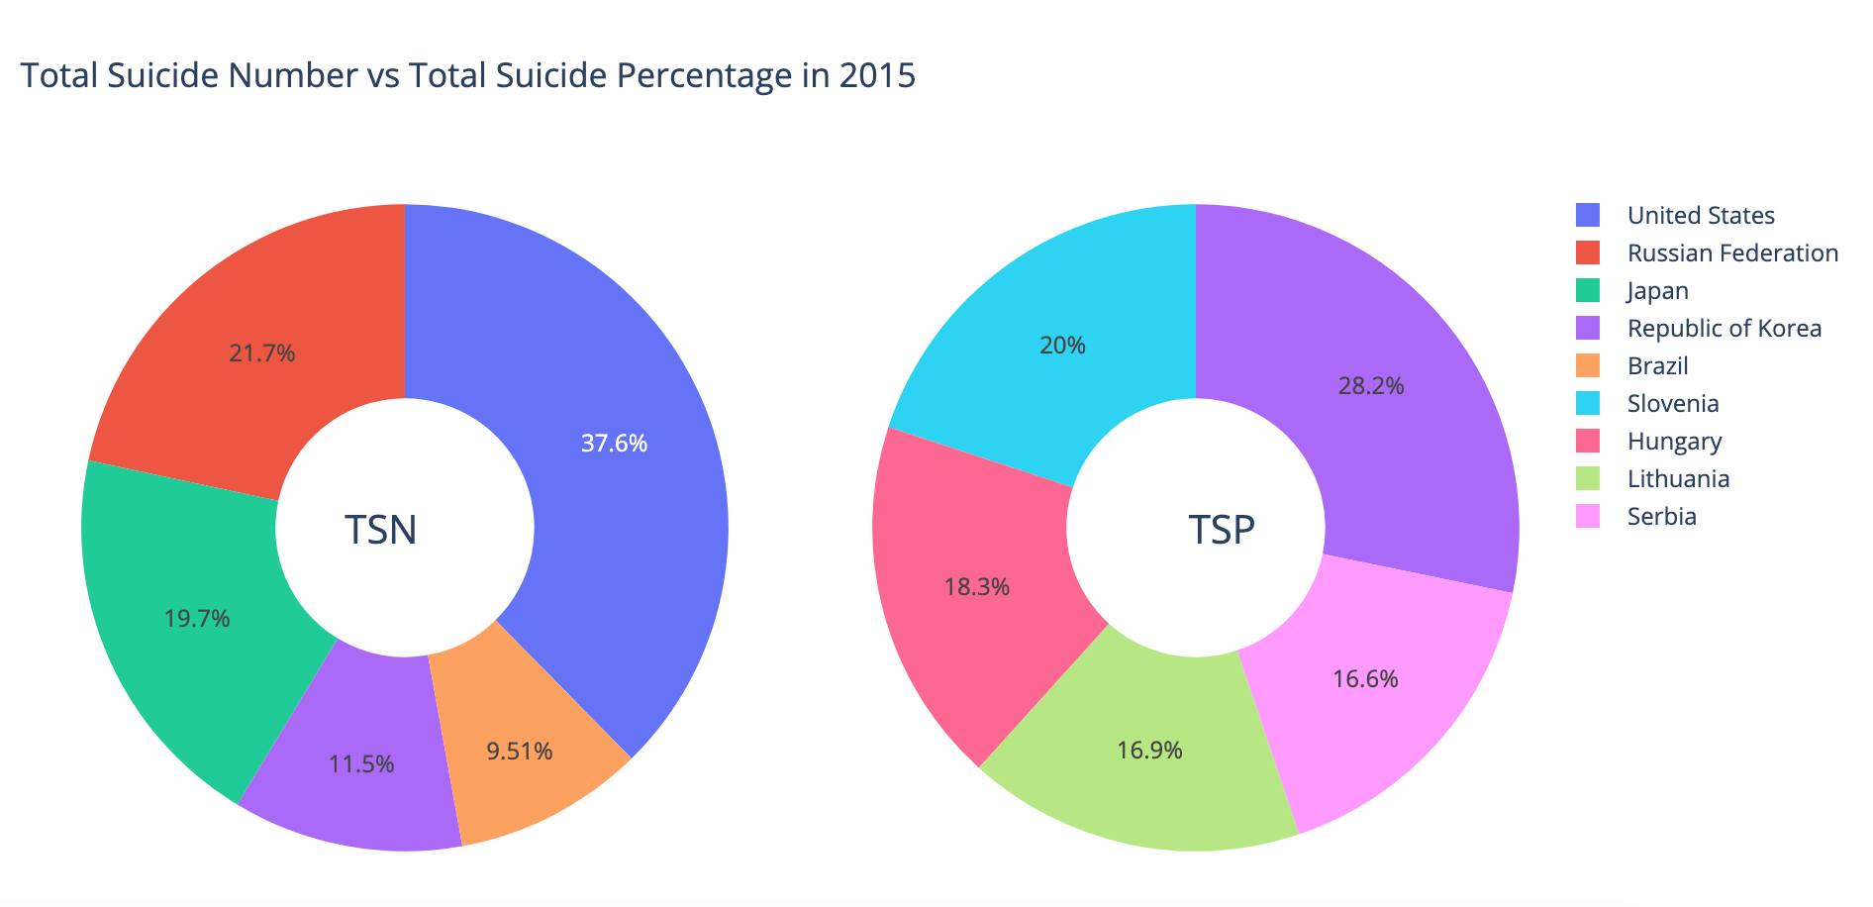

Slide 26
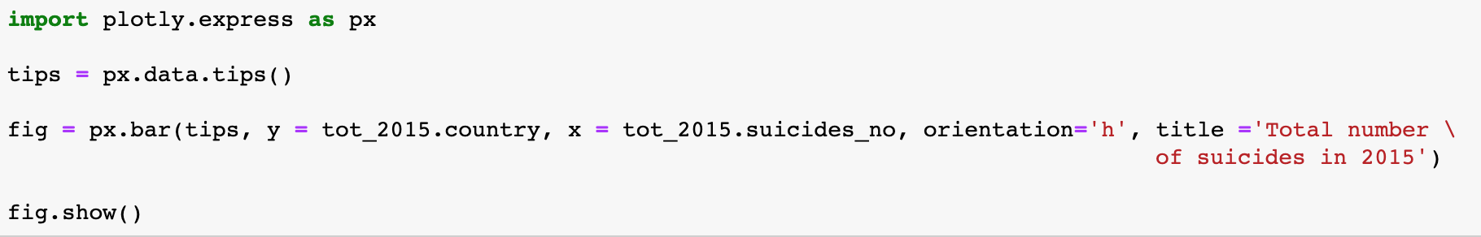

Slide 27
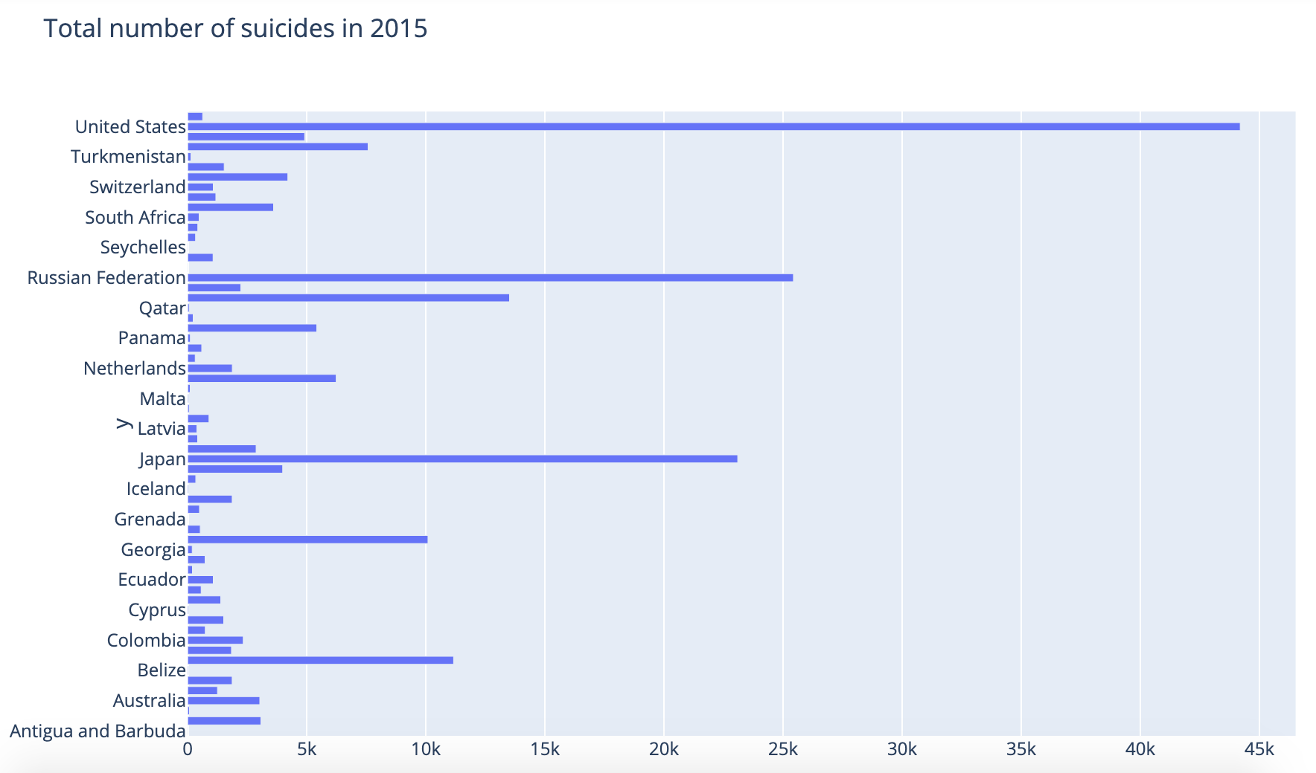

Slide 28
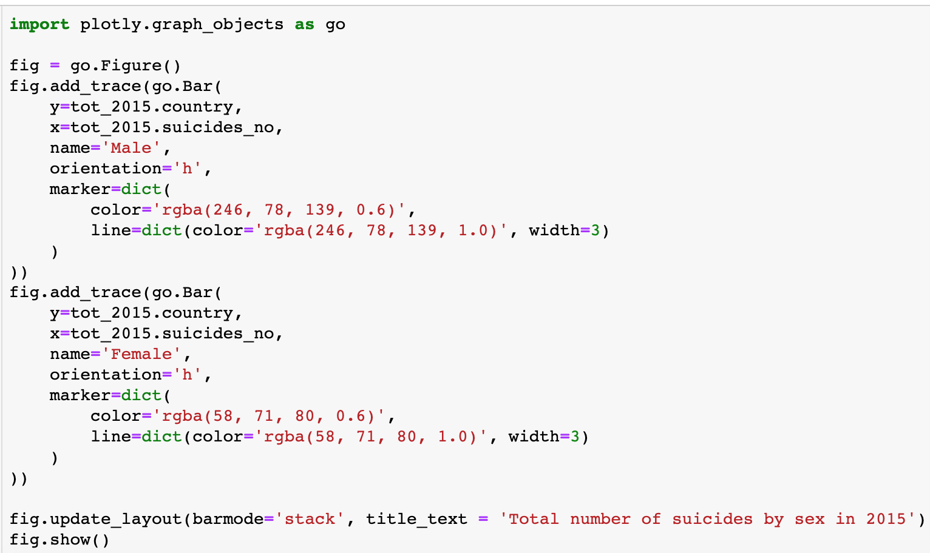

Slide 29
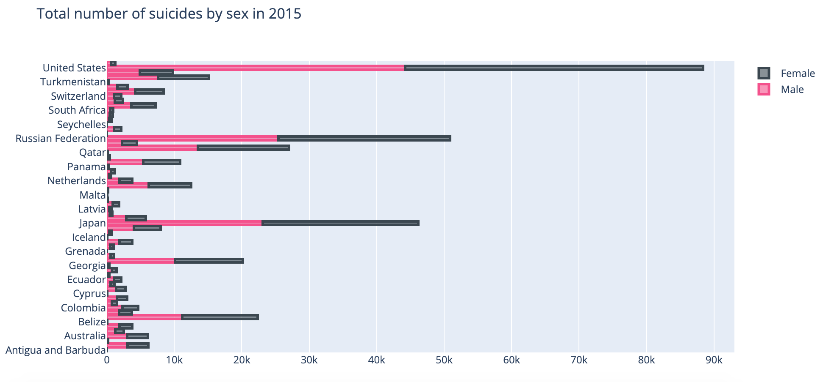

Slide 30
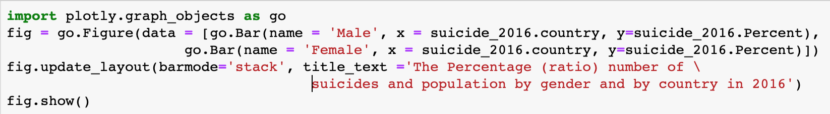

Slide 31
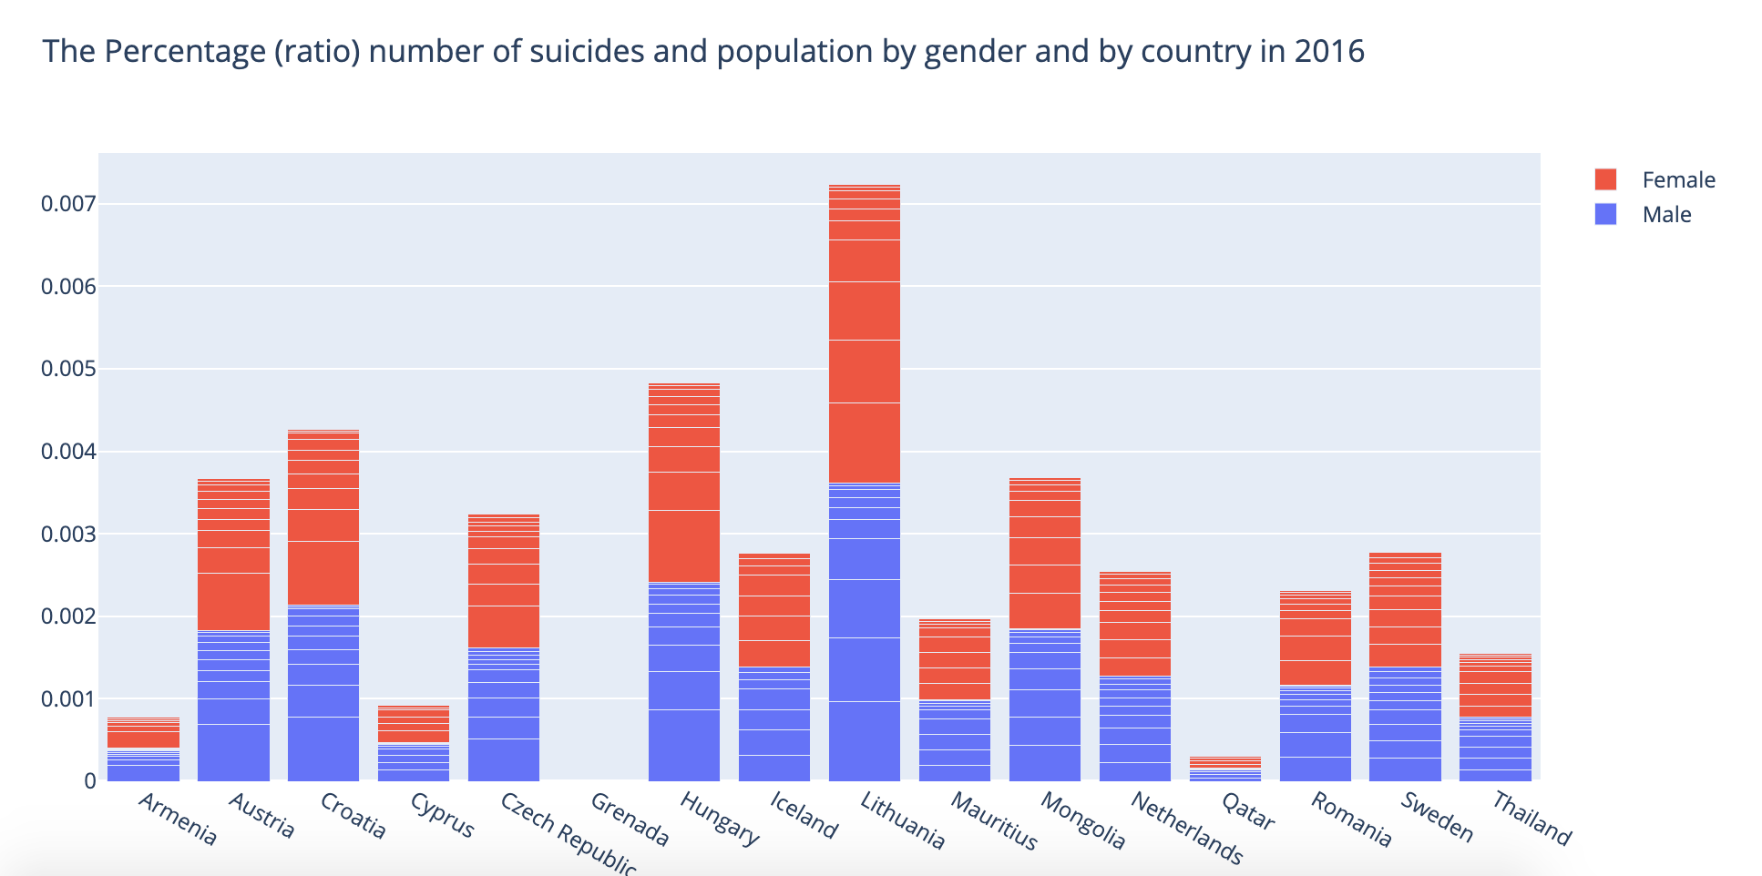

Slide 32
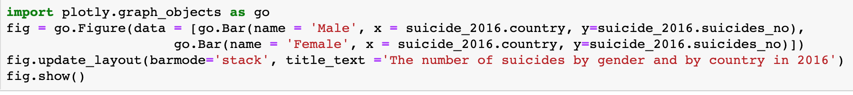

Slide 33
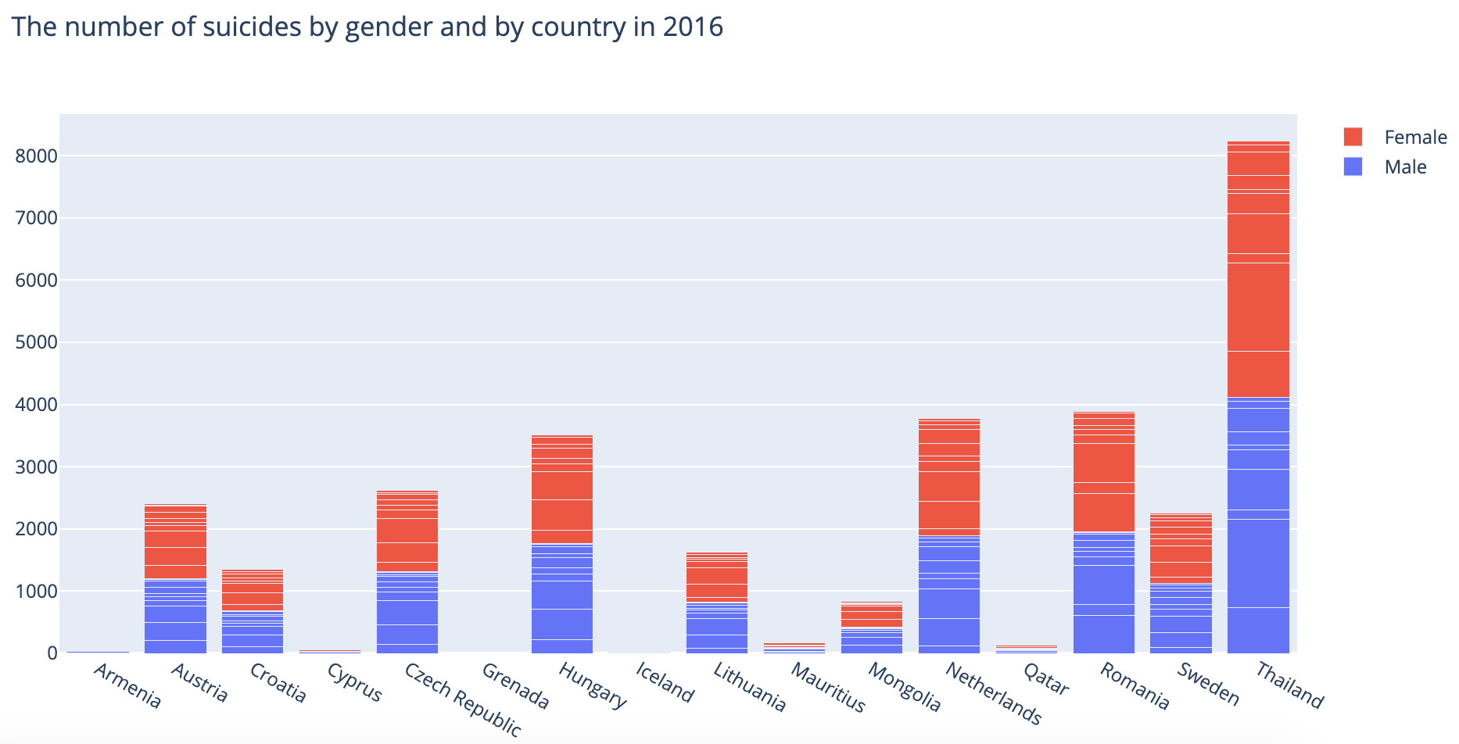

Slide 34
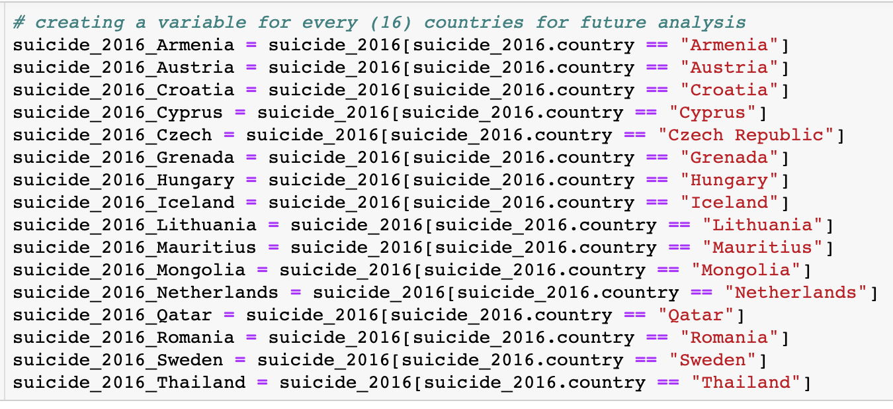

Slide 35
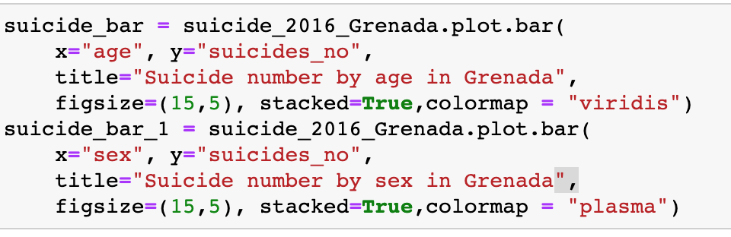
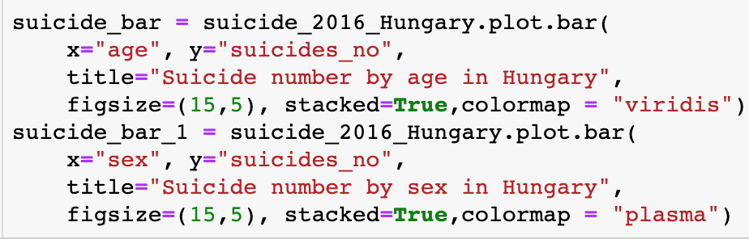
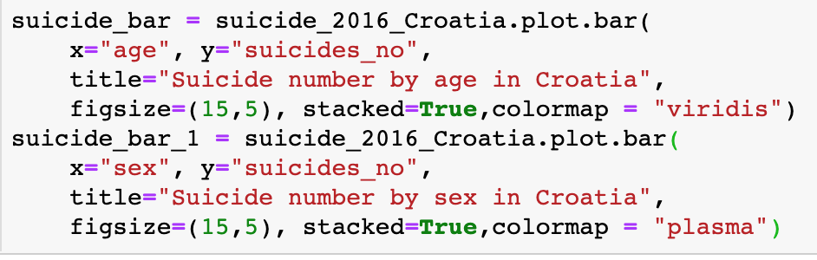
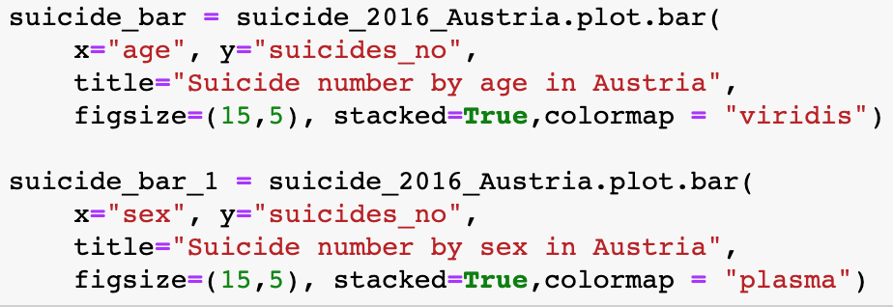
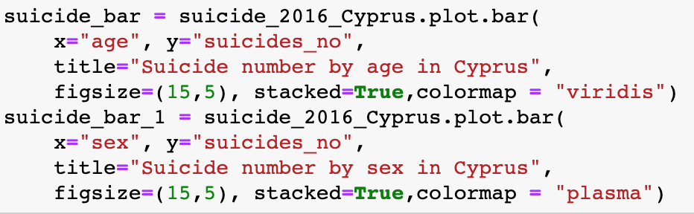
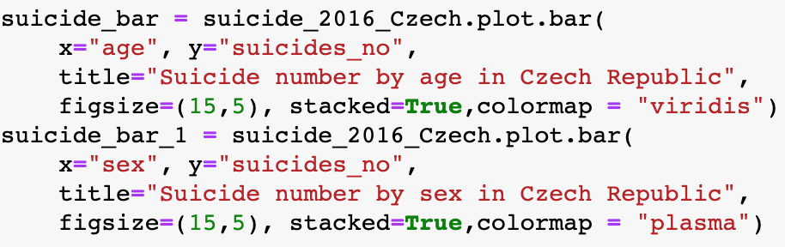

Slide 36
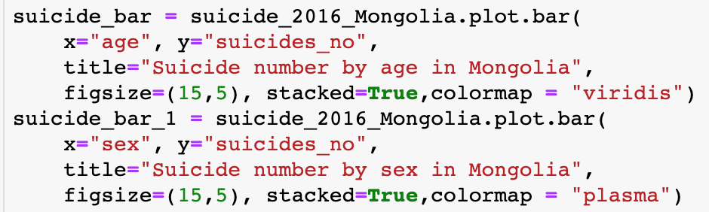
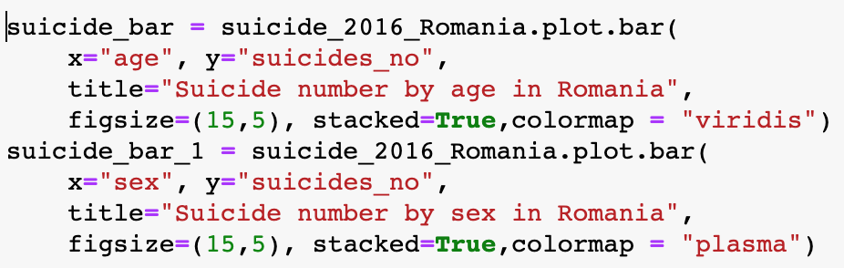
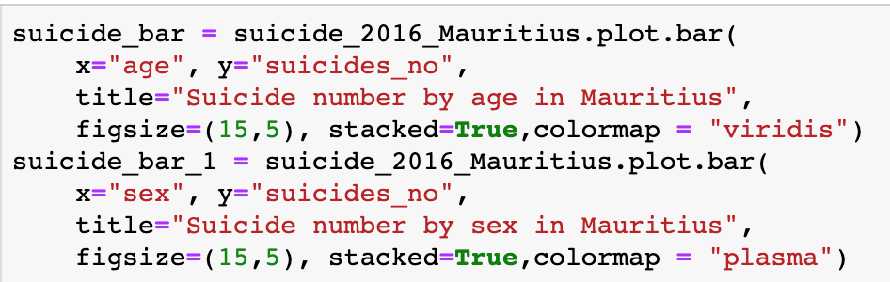
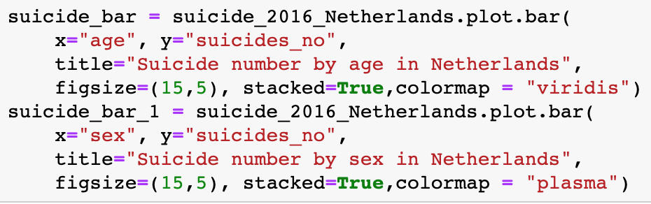
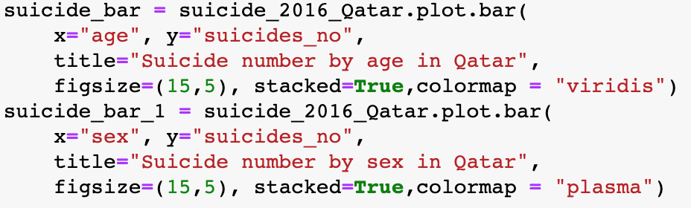

Slide 37
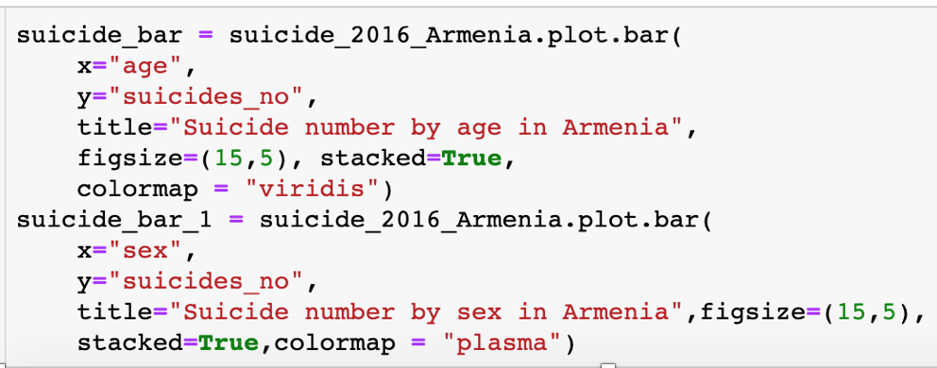

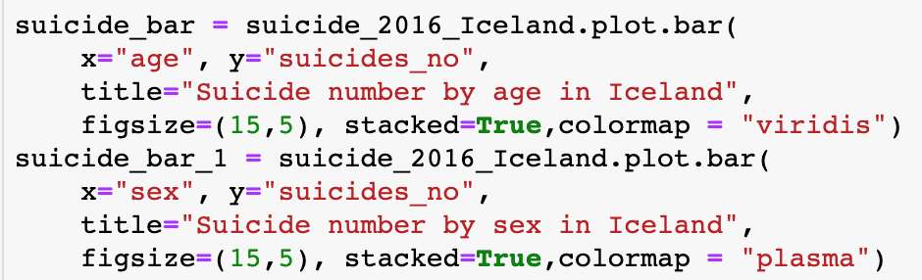
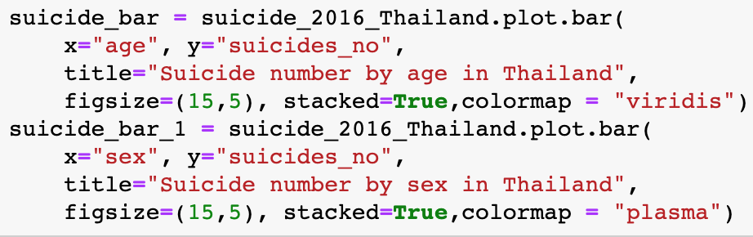

Slide 38
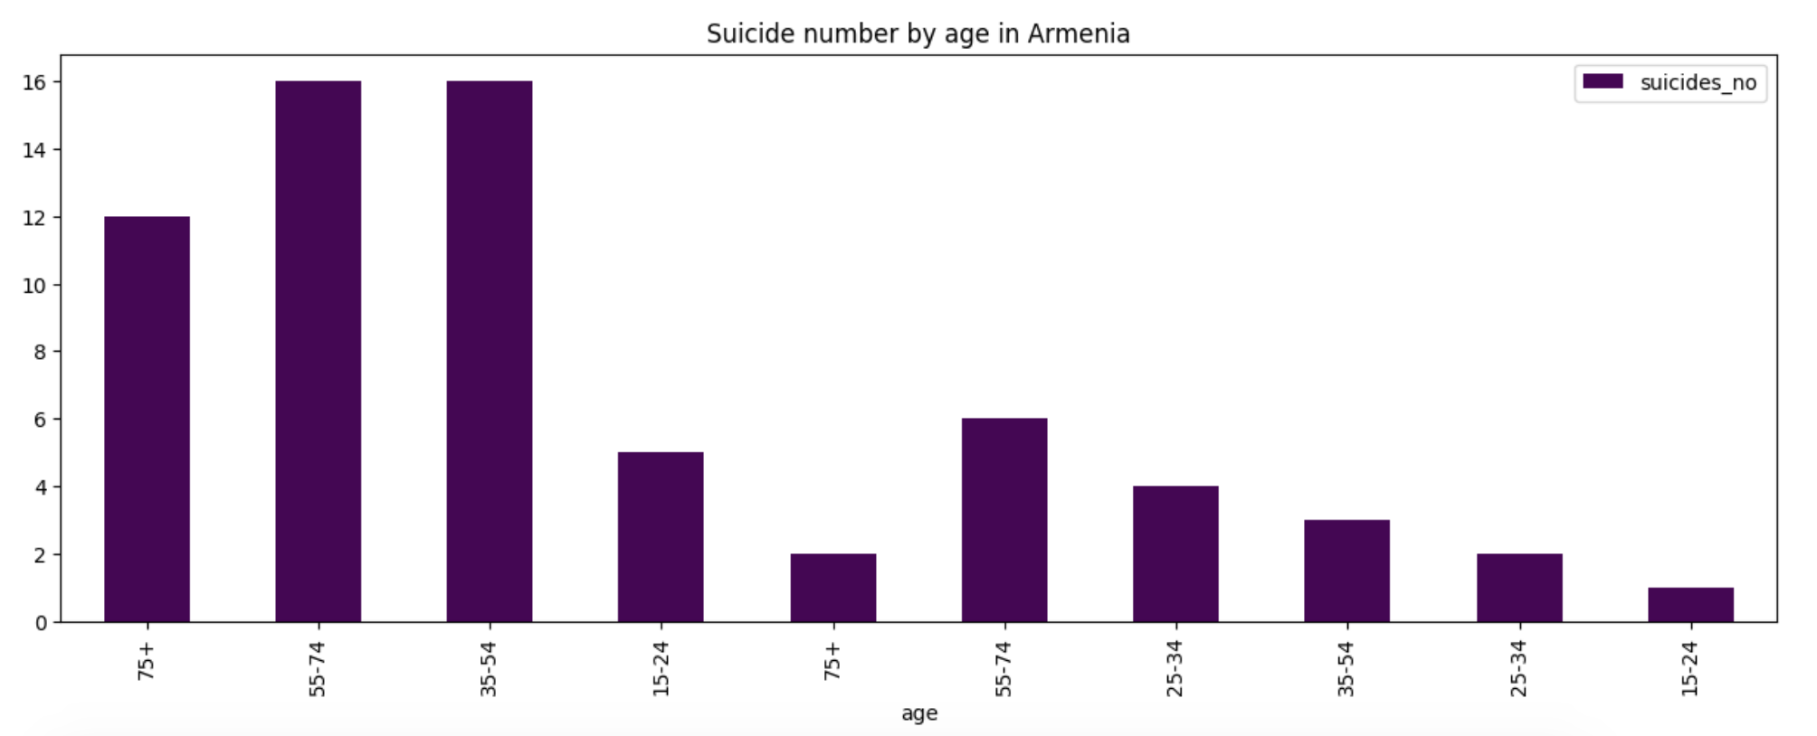


Slide 39



Slide 40



Slide 41



Slide 42



Slide 43



Slide 44



Slide 45



Slide 46



Slide 47



Slide 48



Slide 49



Slide 50



Slide 51



Slide 52



Slide 53



Slide 54



Slide 55



Slide 56


Slide 57
Deaths dataset

Slide 58


Slide 59


Slide 60


Slide 61


Slide 62


Slide 63


Slide 64


Slide 65


Slide 66


Slide 67


Slide 68


Slide 69


Slide 70


Slide 71


Slide 72


Slide 73




Slide 74


Slide 75


Slide 76


Slide 77
Answers for questions:
Q: What are the range of ages suicides occurred mostly?
A: They are 35-54 and 55- 74
Q: Females or males most committed suicides?
A: Males
Q: What are the top 5 countries have the highest number of suicides in 2016?
A: Thailand, Romania, Netherlands, Hungary and Czech Republic
Q: Is this result of countries change consider the population numbers for the countries?
A: Yes, none of the above countries are the top 5 with the high number of suicides. Now they are Lithuania, Hungary, Croatia, Mongolia, and Austria
Q: What are the top 5 countries have the highest number of suicides in 2015?
A: United States, Russia, Japan, Korea, and Brazil
Q: Is this result of countries change consider the population numbers for the countries?
A: Almost, except the Korea. Now it is Korea, Slovenia, Hungary, Lithuania, and Serbia
Q: Is this result are the same as in 2016?
A: Only Lithuania and Hungary.
Q: What are the main causes of deaths in the world in 2017?
A: Cardiovascular disease and maternal disorder.
Q: Are these change in 2016 and 2000?
A: No.
Q: What are the most 2 death diseases in United States, 2017?
A: Dementia and Parkinson disease..
Q: Are these two diseases were the same in 2016 and 2000?
A: Yes, with change in percentages.

Slide 78

Resources:
Our World in Data
Kaggle
https://plot.ly/

